Slide 1
Deep Inverse Sensor Models as Priors for evidential Occupancy Mapping

Slide 2
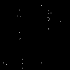

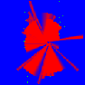


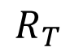
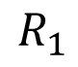
Motivation
360° radar
detections
geo ISM
Where can I drive?
$$R_{1}$$
estimated
occupancy state
reference
occupancy state
$$R_{T}$$
Problems with geo ISMs
initial sparseness of predictions
spatial coherence in the data not utilized
dynamic objects not well captured
Problems of deep ISMs as Priors for OccMaps
accumulation temporal redundancy
deep ISM should only be used for initialization
free | occupied | unknown
Notes:
Initial sparseness: start of operation, see occluded areas or higher speed

Slide 3
Structure
Motivation
Deep ISMs
Uncertainties in deep ISMs
Camera, Lidar and Fused Inputs for deep ISMs
Deep ISMs as Priors for OccMaps
Temporal Redundancy Reduction
Restriction to Initialization

Slide 4
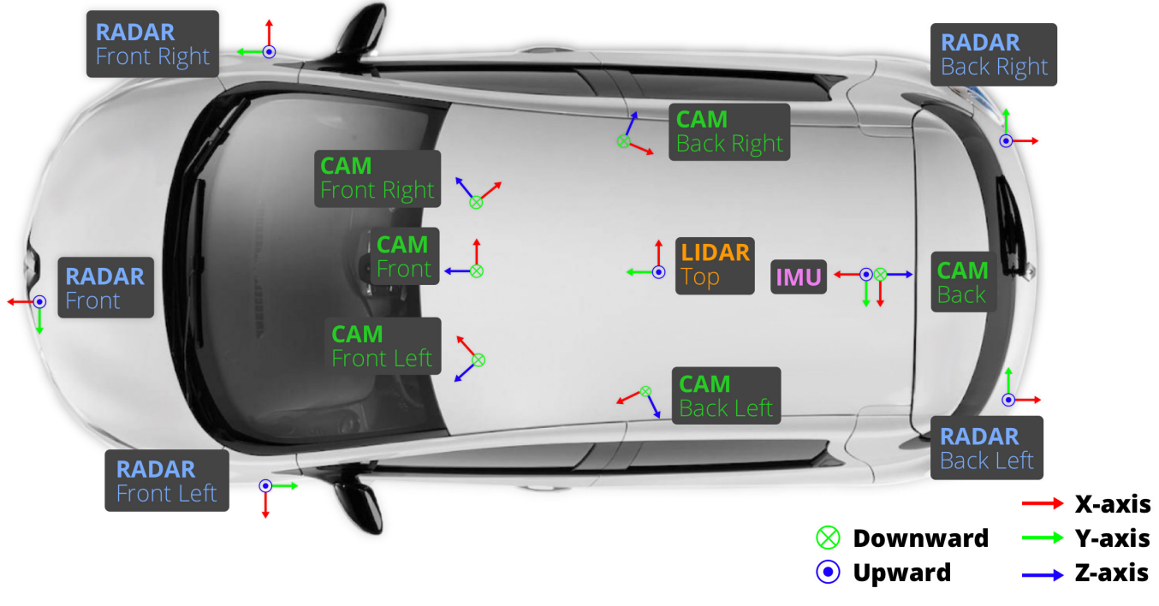
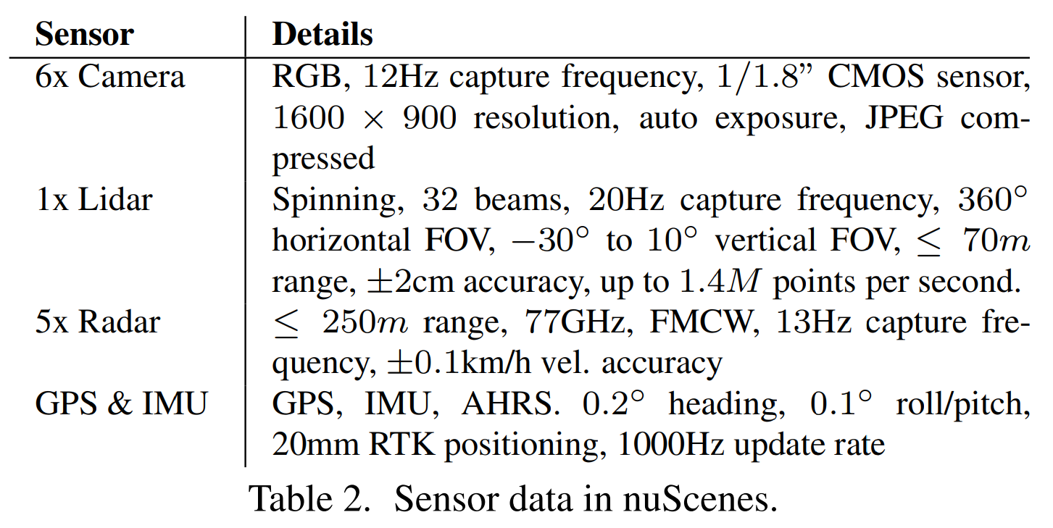
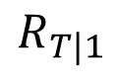
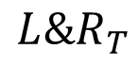
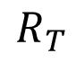
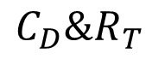
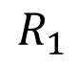
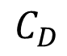
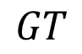
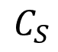
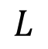
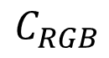
Dataset
$$L$$
$$GT$$
$$R_{1}$$
$$R_{T}$$
$$R_{T|1}$$
$$C_{RGB}$$
$$C_{S}$$
$$C_{D}$$
$$C_{D}\&R_{T}$$
$$L\&R_{T}$$

Slide 5
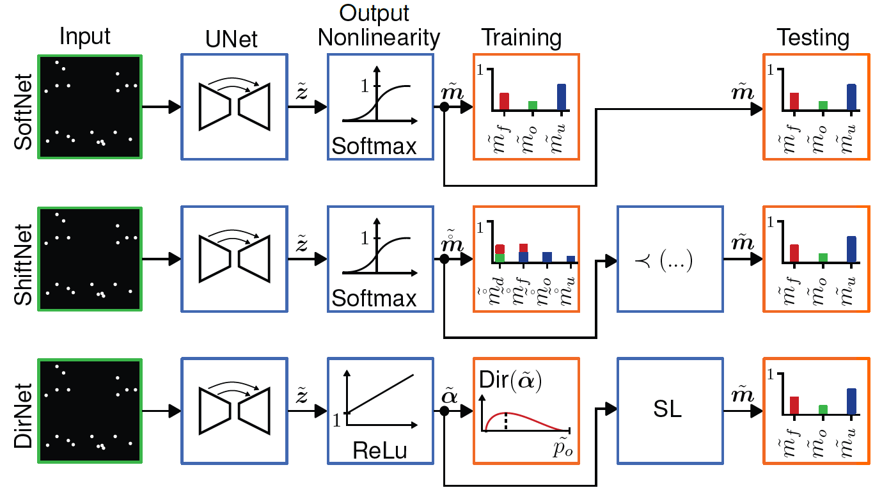
Unknown vs. Dynamic

Slide 6
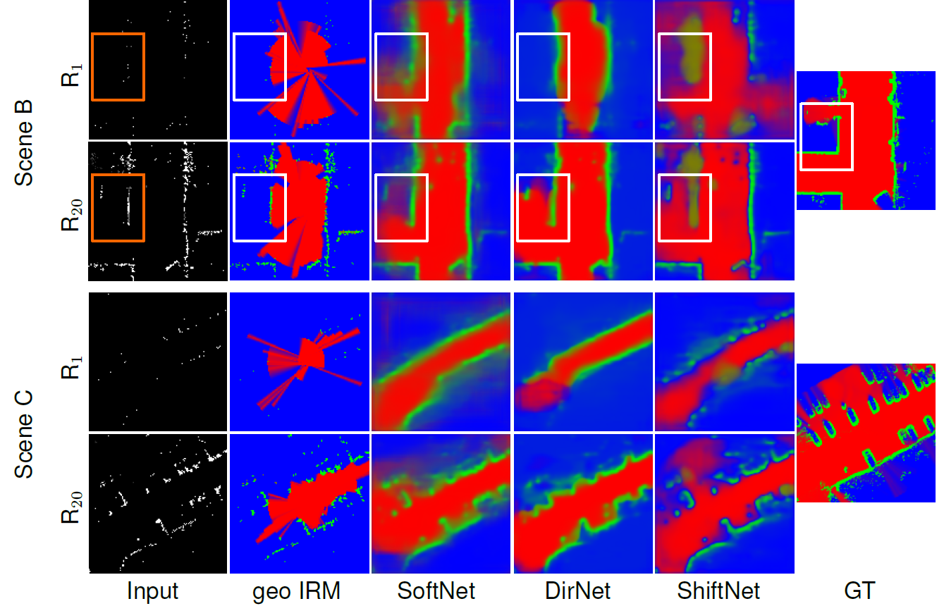
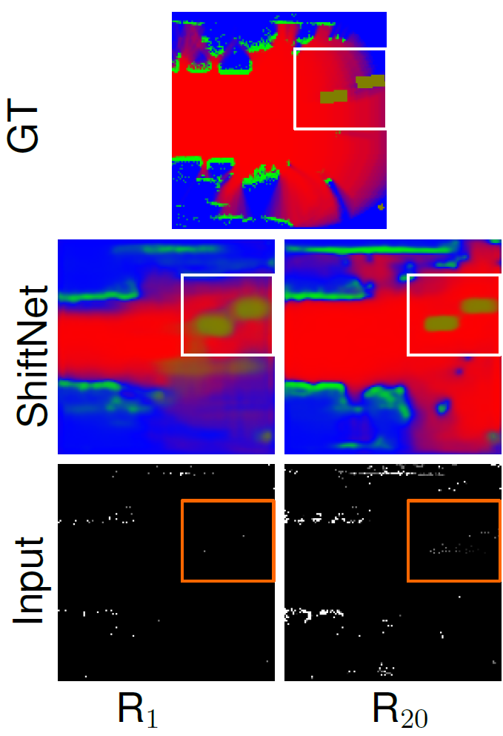
Unknown vs. Dynamic

Slide 7
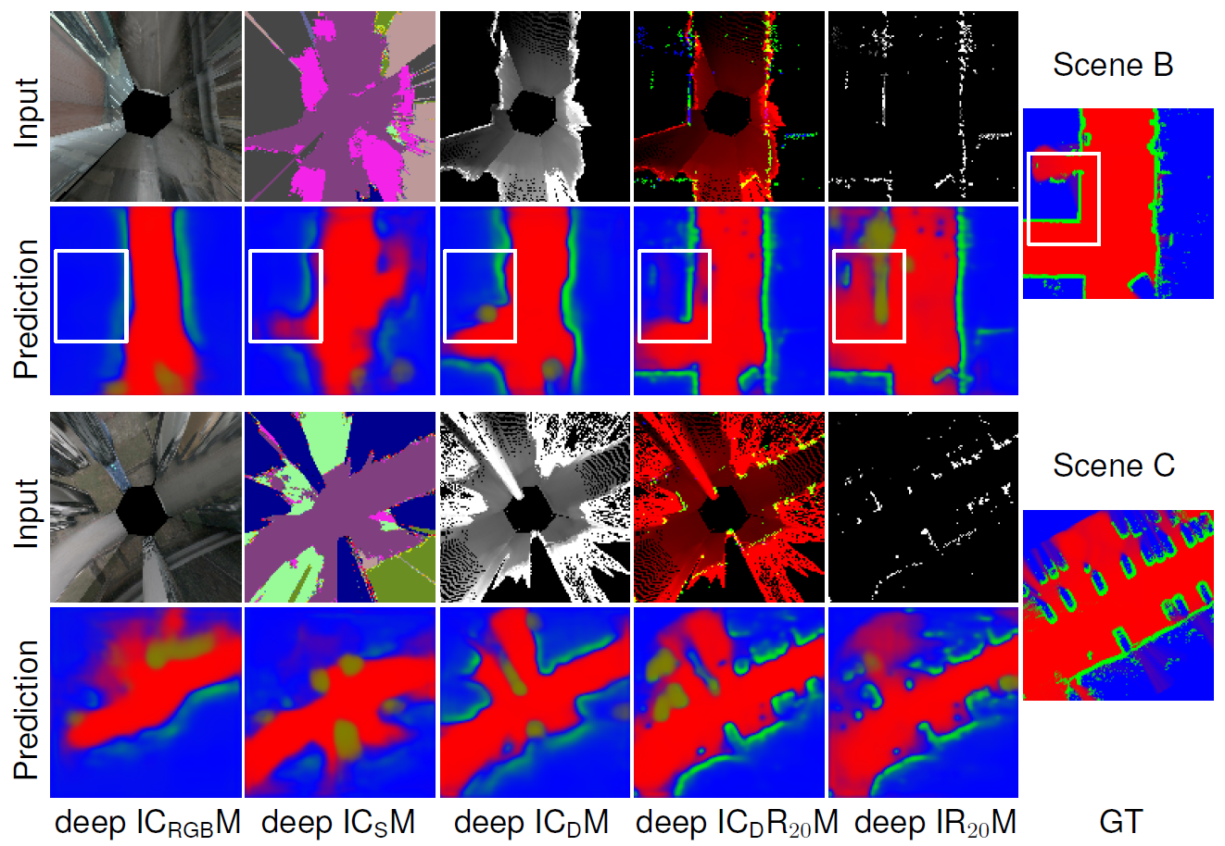
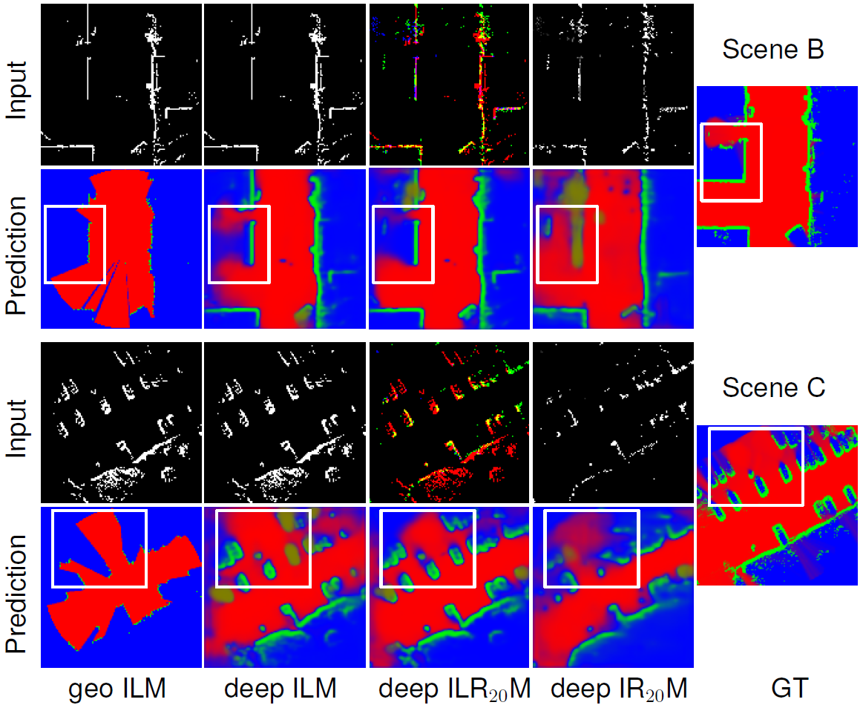
Deep ISM Input Comparison
Camera
Lidar

Slide 8
Structure
Motivation
Deep ISMs
Uncertainties in deep ISMs
Camera, Lidar and Fused Inputs for deep ISMs
Deep ISMs as Priors for OccMaps
Temporal Redundancy Reduction
Restriction to Initialization

Slide 9
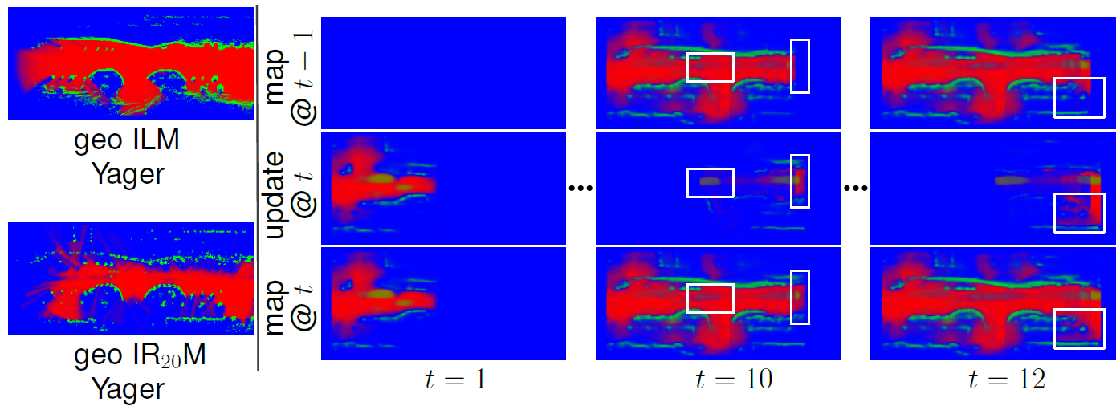
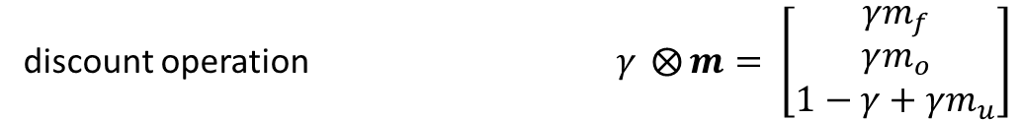
Redundancy reduced Update
discount operation $γ ⨂{m}= \left[\begin{matrix}γm_{f} \\ γm_{o} \\ 1−γ+γm_{u}\end{matrix}\right]$
redundancy reduction factor $γ=ReLU\left(Δm_{u}+K\right)∈[0,1]$
Notes:
m_u can be regarded as information measure
It contains info about unknown as well as uncertain areas

Slide 10
Temporal Redundancy
GT
geo IRM
deep IRM
geo & deep
IRM
deep, red.
IRM

Slide 11
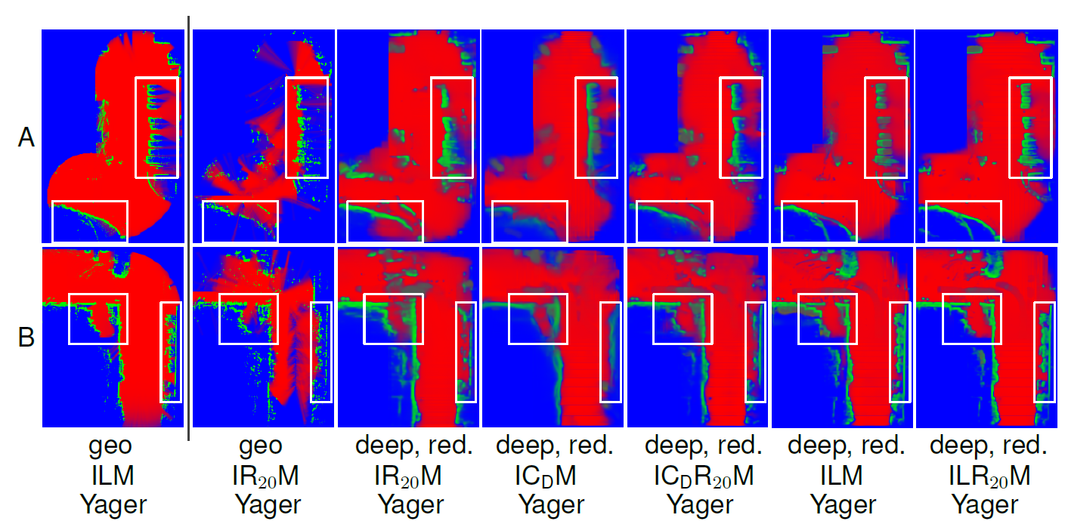
OccMaps from Radar, Cam & Lidar

Slide 12
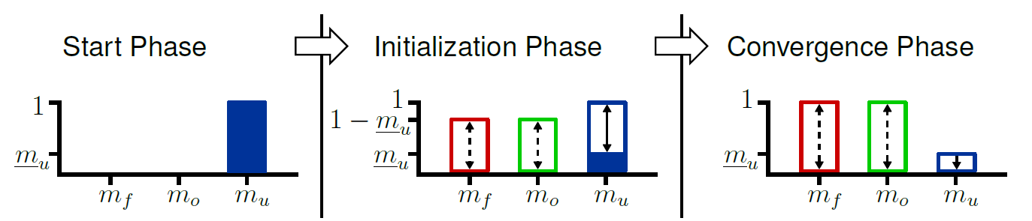
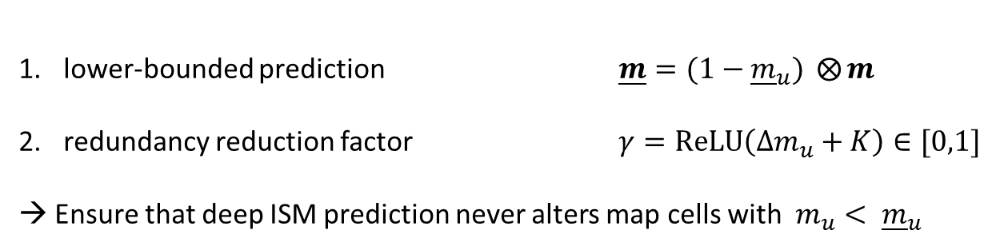
Deep IRMs as Priors
lower-bounded prediction $\underline{m}=(1−{\underline{m}}_{u}) ⨂{m}$
redundancy reduction factor $γ=ReLU\left(Δm_{u}+K\right)∈[0,1]$
→ Ensure that deep ISM prediction never alters map cells with ${m_{u}< \underline{m}}_{u}$

Slide 13
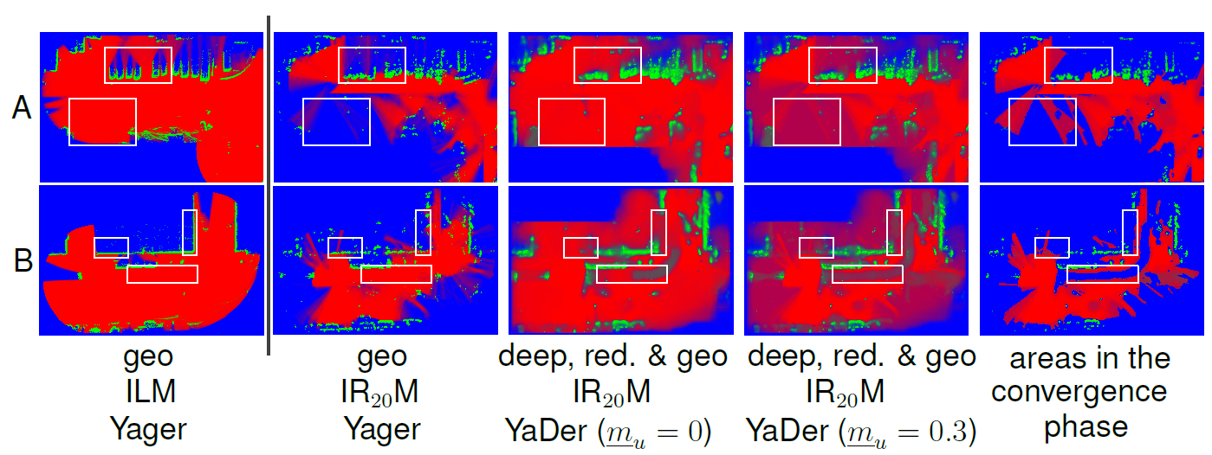
Deep IRMs as Priors

Slide 14
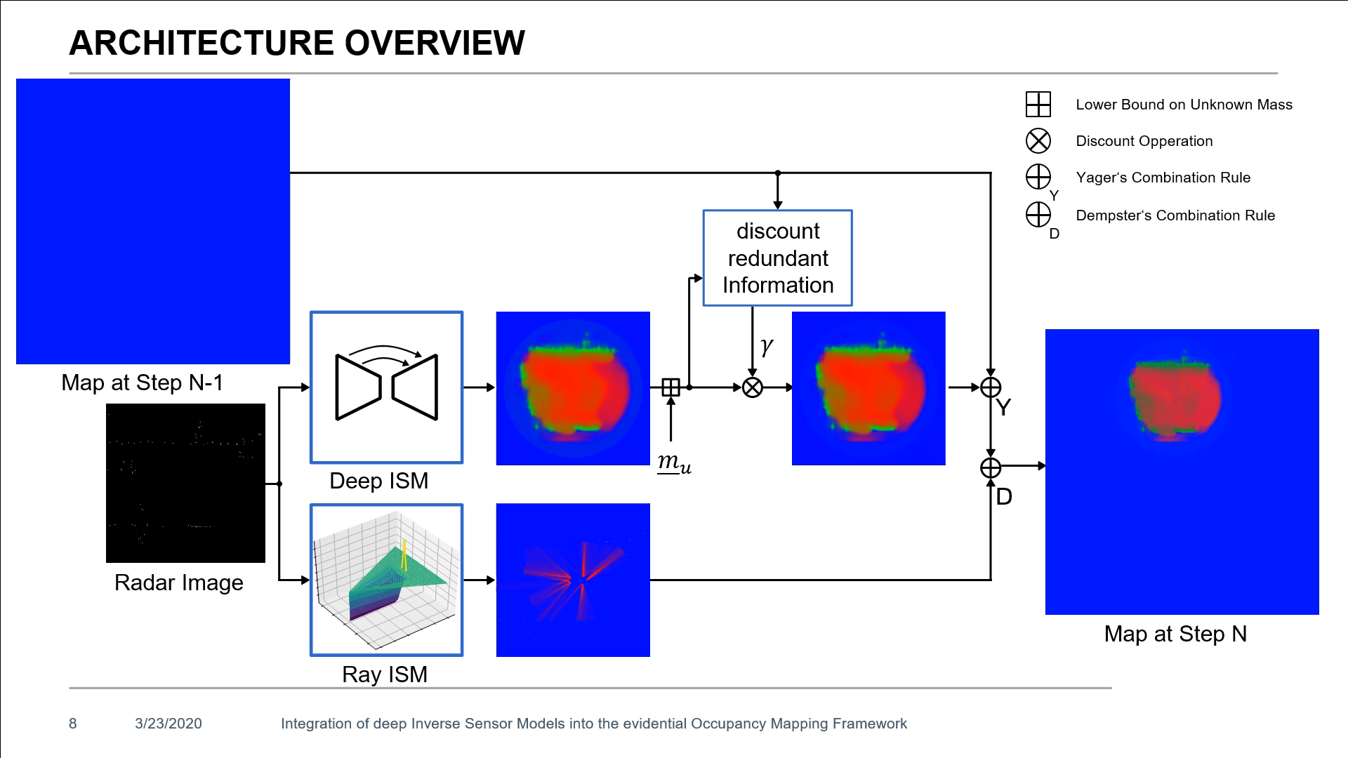
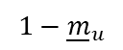
Redundancy reduced Update
$$1−{\underline{m}}_{u}$$
Notes:
m_u can be regarded as information measure
It contains info about unknown as well as uncertain areas

Slide 15
Appendix

Slide 16
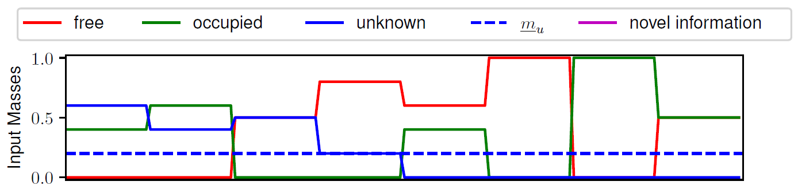
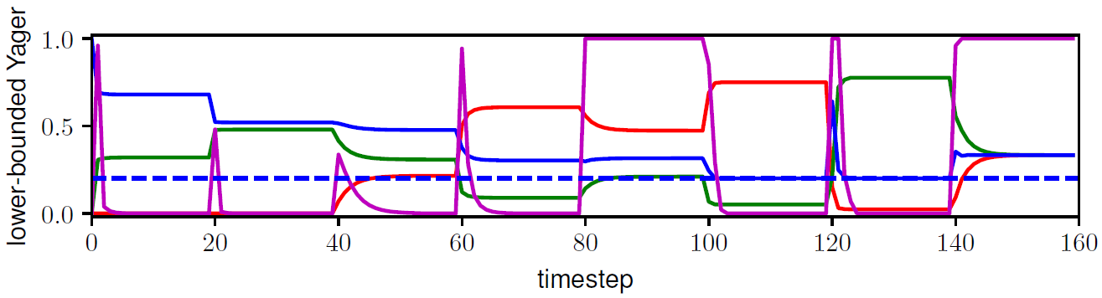
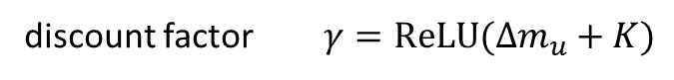
Redundancy reduced Update
discount factor $γ=ReLU(Δm_{u}+K)$

Slide 17
Custom Radar, Lidar & Odometry Dataset
28843 training
4775 validation
4775 testing

Slide 18
Motivation

